Slide 1

Math in the Street: An Investigation
M1: Chelsie Hill, Hannah Taylor, Asha Parkinson Tee, Lieke Wolbers

Slide 2

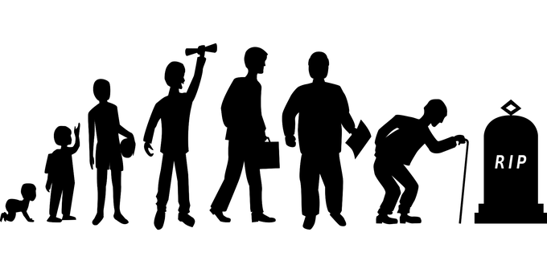
Research Questions:
How Do Strategies Vary by Nationality?
How Do Strategies Vary by Age?

Slide 3
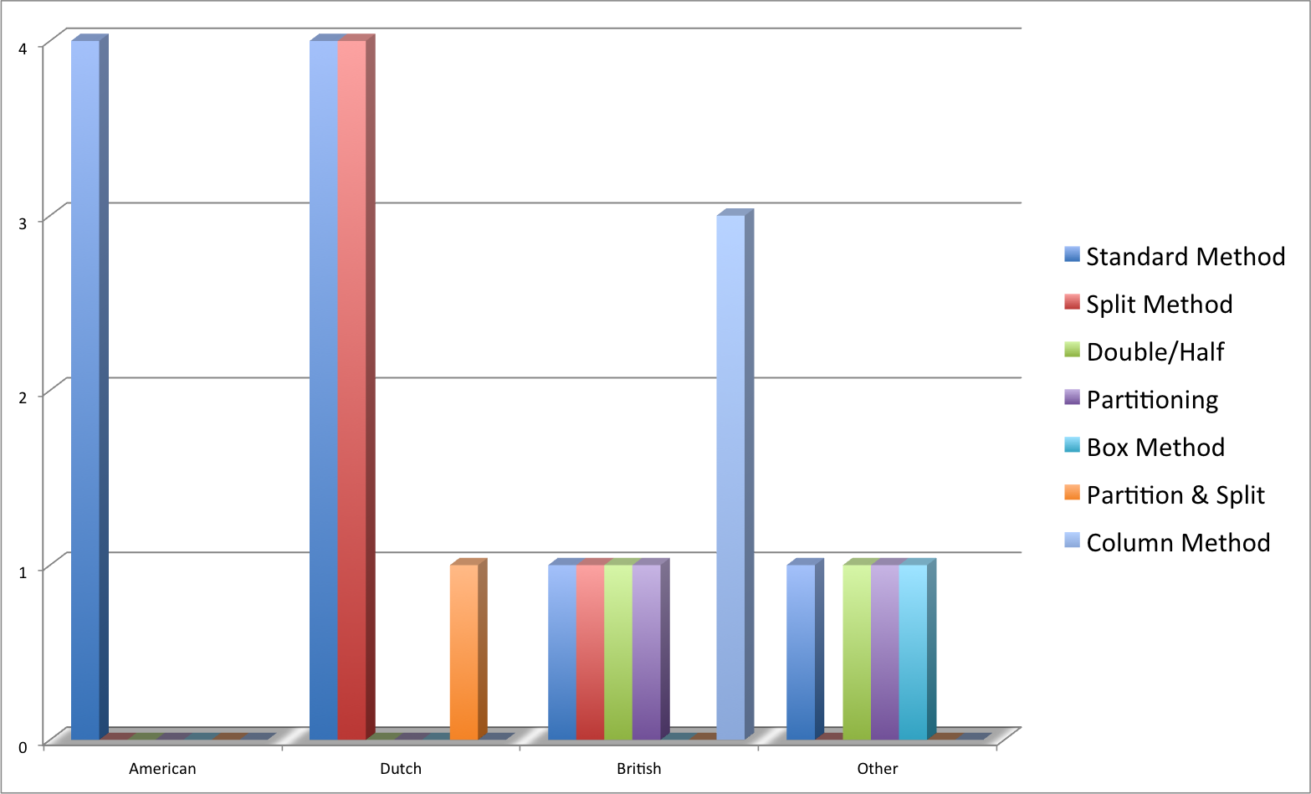
Problem #1: 36 x 175
Nationality
Notes:
American: Standard Method
Dutch: Standard Method/Split Method
British: Standard Method
Other:Standard Method/Double/Half/Partitioning/Column Method

Slide 4
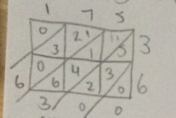
Box Method
The box method splits numbers into their place values and involves multiplying each value from both operands with each other

Slide 5
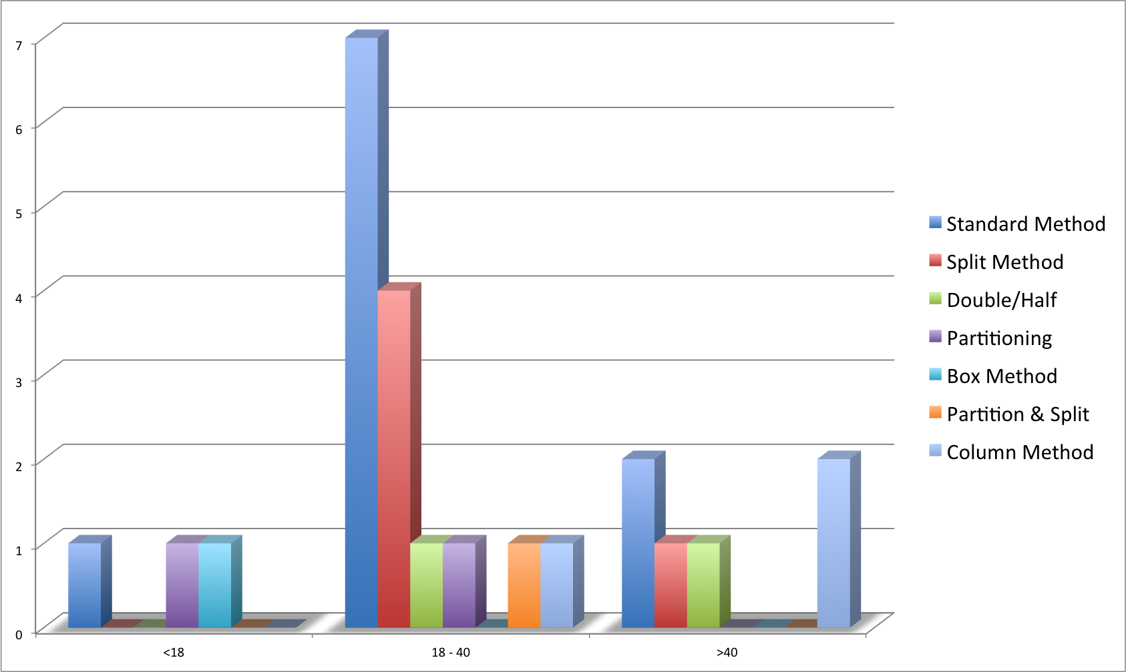
Problem #1: 36 x 175
Age
Notes:
<18 – Standard method, partitioning and model version
18-40 – Standard method and split method
>40 – Standard method, column method

Slide 6
Strategies Used: A Conclusion
Standard Method
Split Method
Double/Half
Partitioning
Box Method
Partition & Split
Column Method
Most common strategies:
  Standard Method
  <18 – Standard method, partitioning and model version
  18-40 – Standard method and split method
  >40 – Standard method, column method
Most effective strategies:
  Standard method

Slide 7
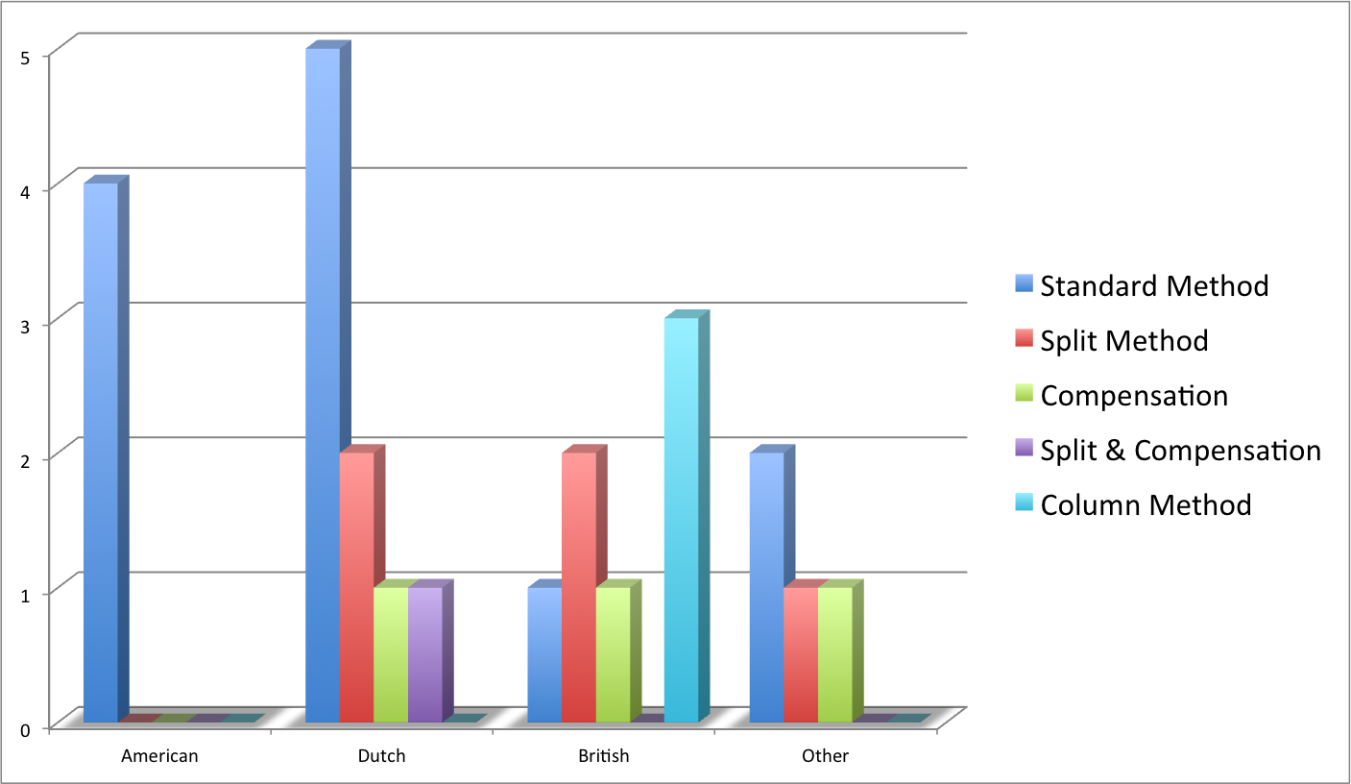
Problem #2: 998.13 – 98.87
Nationality
Notes:
American: Standard Method
Dutch: Standard Method
British: Split Method
Other: Standard Method

Slide 8
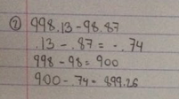
Split method
Splitting the numbers into friendlier numbers
Solve both of the new equations
Combine answers

Slide 9
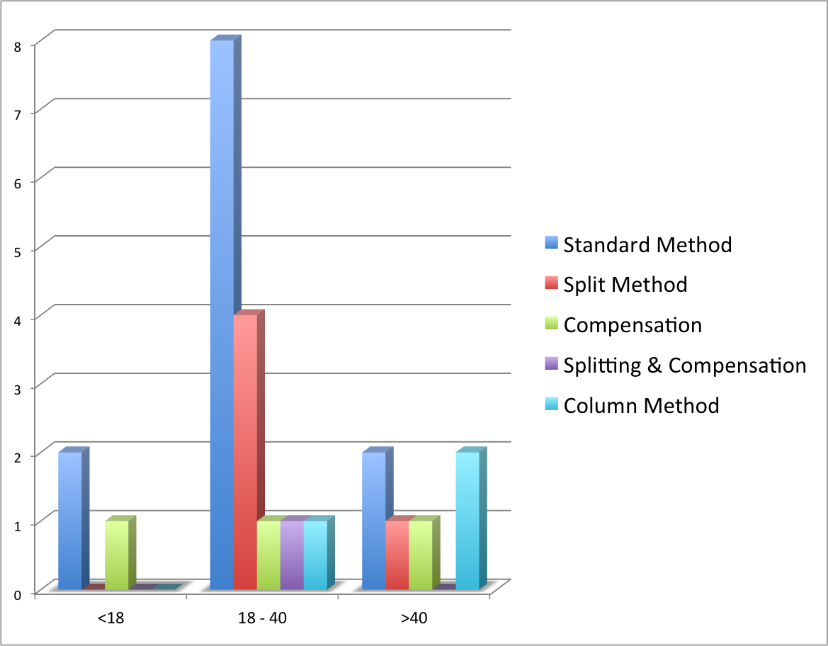
Problem #2: 998.13 – 98.87
Age
Notes:
<18 – Standard method, compensation
18-40 – Standard method, split
>40 – standard method and column

Slide 10
Strategies Used: A Conclusion
Standard Method
Split Method
Compensation
Splitting & Compensation
Column Method
Most common strategies:
  Standard Method/Split
  <18 – Standard method, compensation
  18-40 – Standard method, split
  >40 – Standard method and column
Most effective strategies:
  Split method
  Standard method

Slide 11
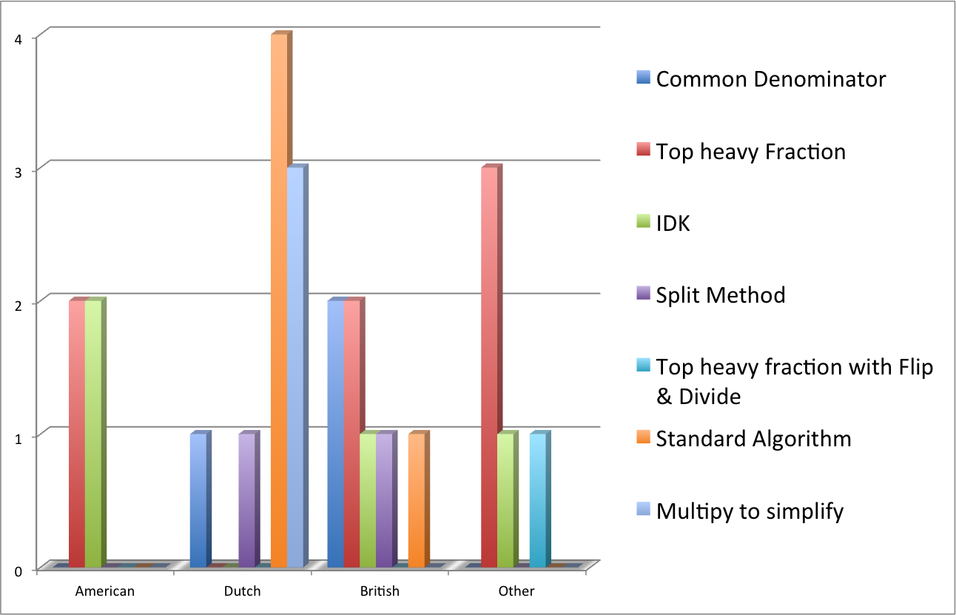
Problem #3: 70 : 2 1/3
Nationality
Notes:
American: Top heavy Fraction/IDK
Dutch: Standard Algorithm
British: Common Denominator/Top heavy Fraction
Other: Top heavy fraction

Slide 12
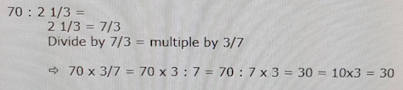
Top-Heavy Fraction/Flip & Divide
Change the mixed number into a top-heavy fraction
Divide by the fraction (same as multiply by the denominator (how many thirds, fifths, sixths, etc.) and divide by the numerator (how many servings)

Slide 13
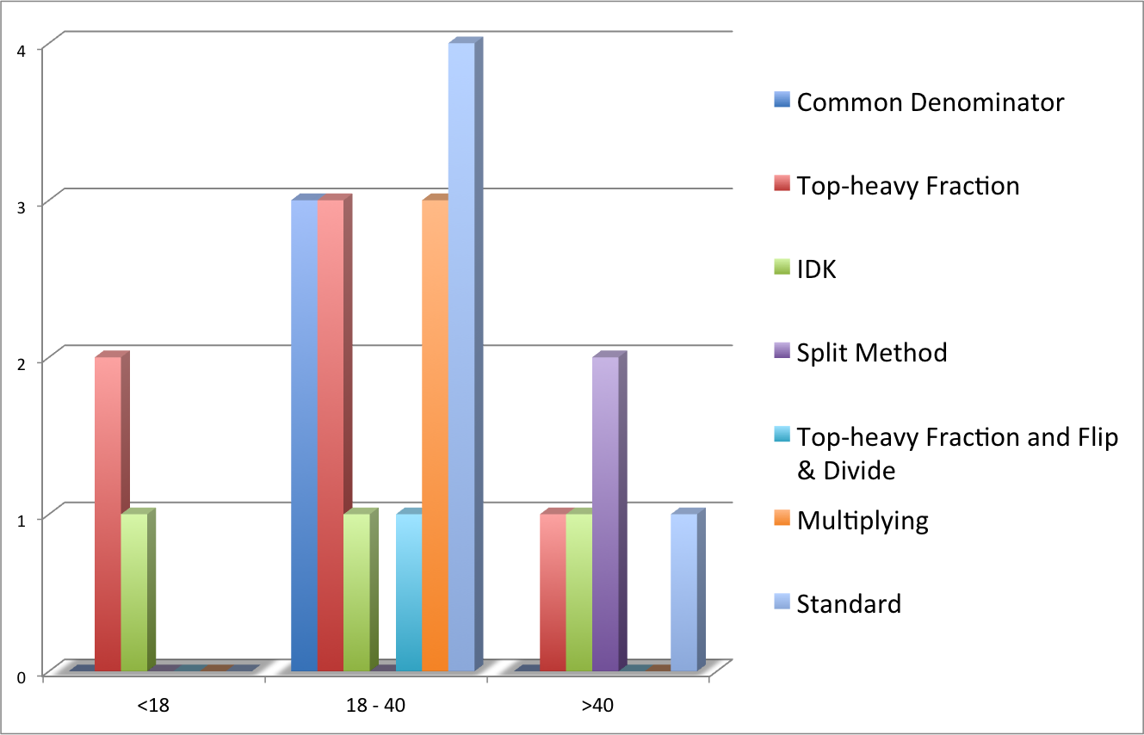
Problem #3: 70 : 2 1/3
Age
Notes:
<18 – Top heavy fraction, IDK
18 – 40 – Standard algorithm, top heavy fractions, IDK, multiplying
>40 – split method, standard algorithm

Slide 14
Strategies Used: A Conclusion
Standard
Common Denominator
Top-heavy Fraction
Split Method
Top-heavy Fraction w/ Flip & Divide
Multiplying
IDK
Most common strategies:
  Top-heavy Fraction/ Common Denominator
  <18 – Top heavy fraction, IDK
  18 – 40 – Standard algorithm, top heavy fractions, IDK, multiplying
  >40 – split method, standard algorithm
Most effective strategies:
- Top heavy fraction with flip and divide

Slide 15
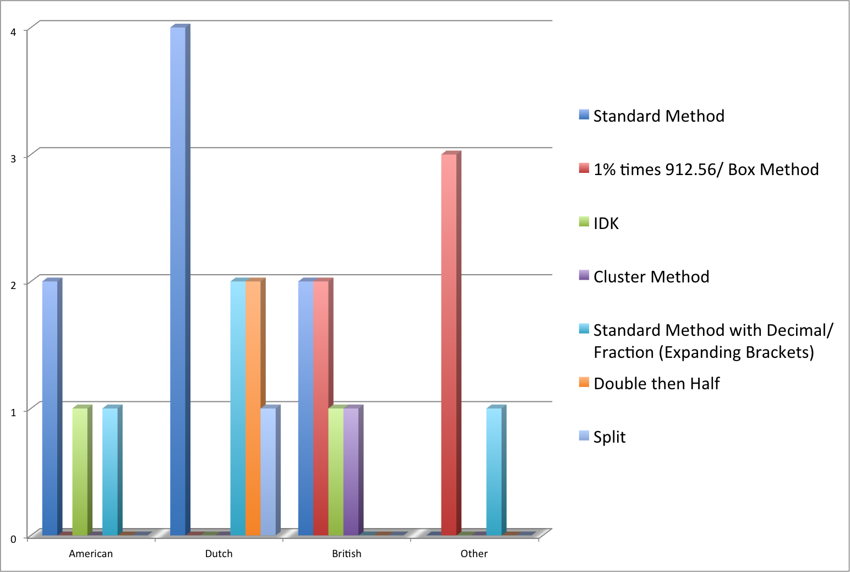
Problem #4: 37.5% of $912.56
Nationality
Notes:
American: Standard Method
Dutch: Standard Method
British: Standard Method/1% times 912.56/Box Method(Mention box method only once)
Other:1% times 912.56

Slide 16
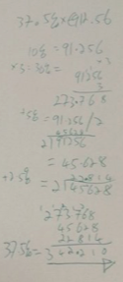
Cluster Method
Find friendly numbers and solve smaller clusters problems
Then add answers to cluster problems for the total amount

Slide 17
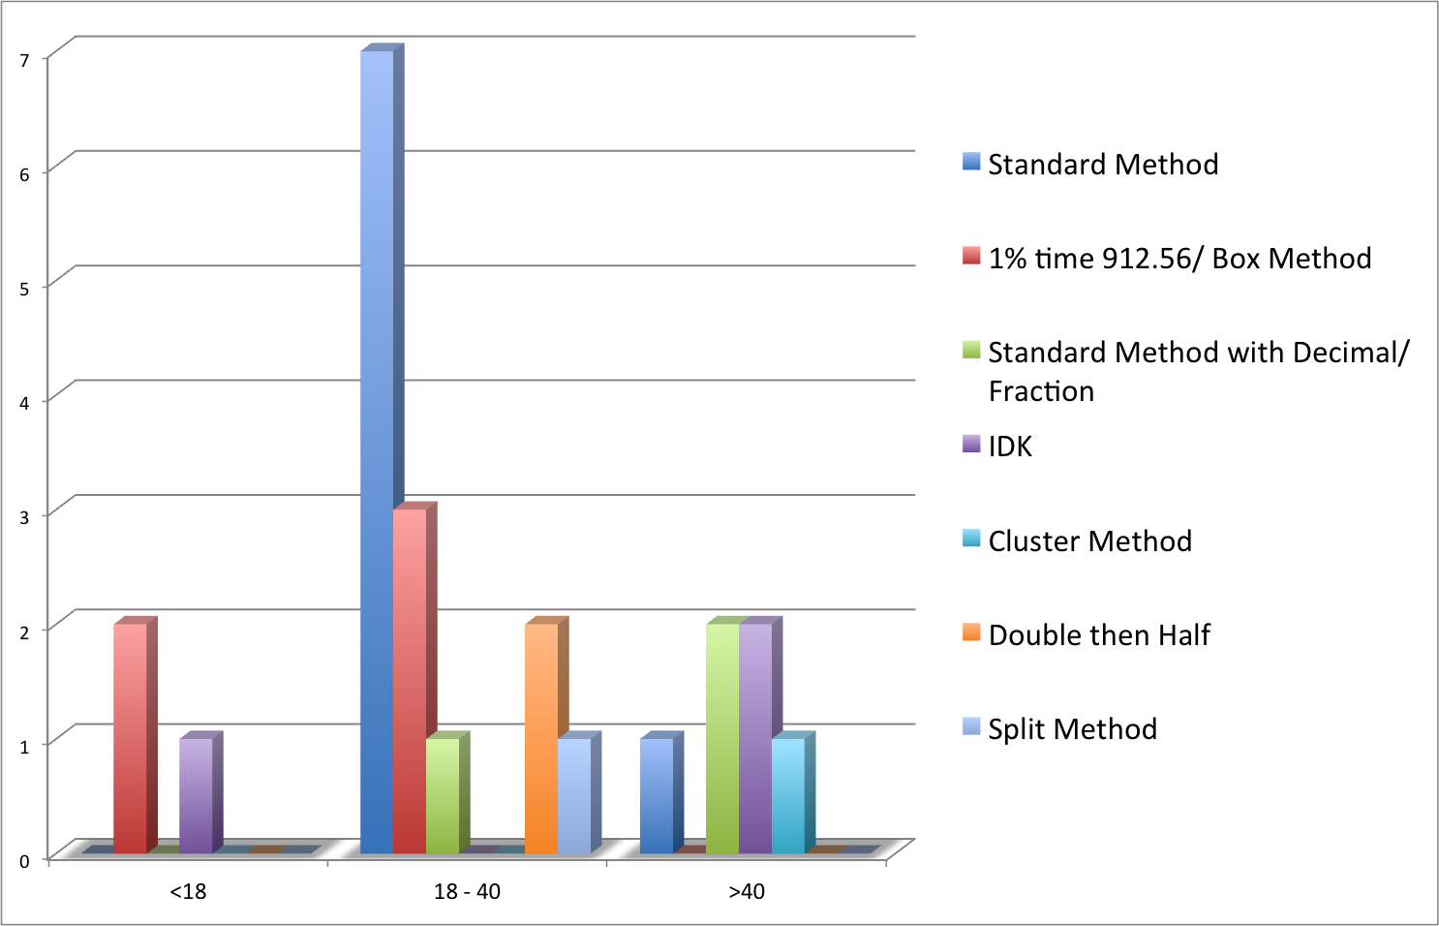
Problem #4: 37.5% of $912.56
Age
Notes:
<18 – 1% times 912.56 (box method), IDK
18-40 – Standard algorithm, 1% times 912.56 (box method)
>40 – Standard method with decimal/fraction, IDK

Slide 18
Strategies Used: A Conclusion
Standard Method
1% times 912.56/Box Method
Standard Method w/ conversion to decimal or fraction
Cluster Method
Double then half
Split Method
IDK
Most common strategies:
  Standard Method/ 1% times 912.56
  <18 – 1% times 912.56 (box method), IDK
  18-40 – Standard algorithm, 1% times 912.56 (box method)
  >40 – Standard method with decimal/fraction, IDK
Most effective strategies:
1% of 912.56

Slide 19
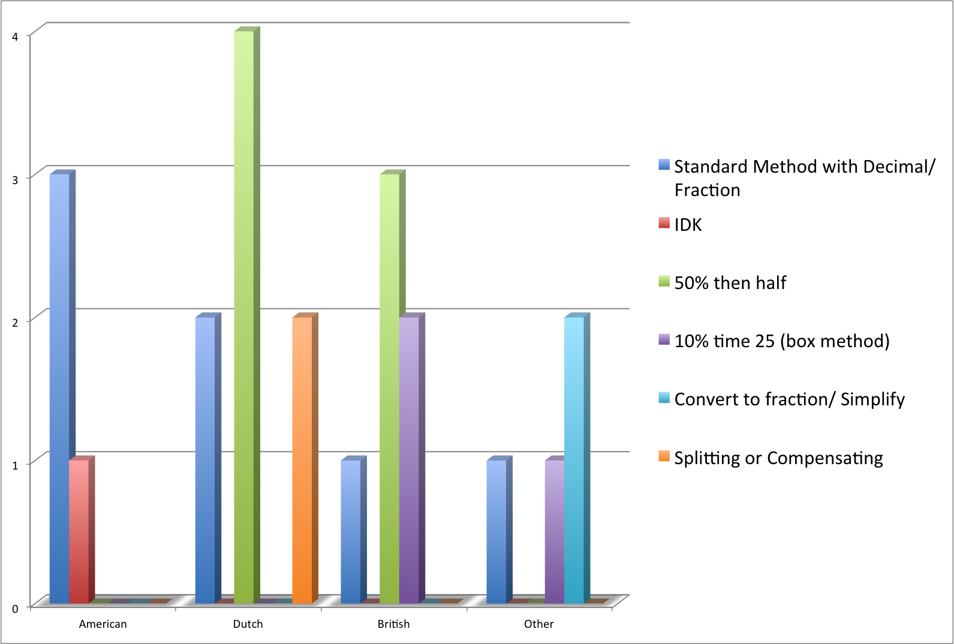
Problem #5: 25% of $3.72
Nationality
Notes:
American: Standard Method with Decimal/Fraction
Dutch:50% then half
British:50% then half
Other:Convert to fraction/Simplify

Slide 20
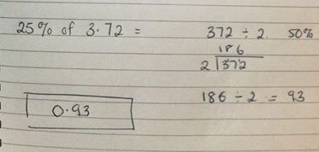
50% then half
Find 50% or :2
Then half the answer for the final amount

Slide 21
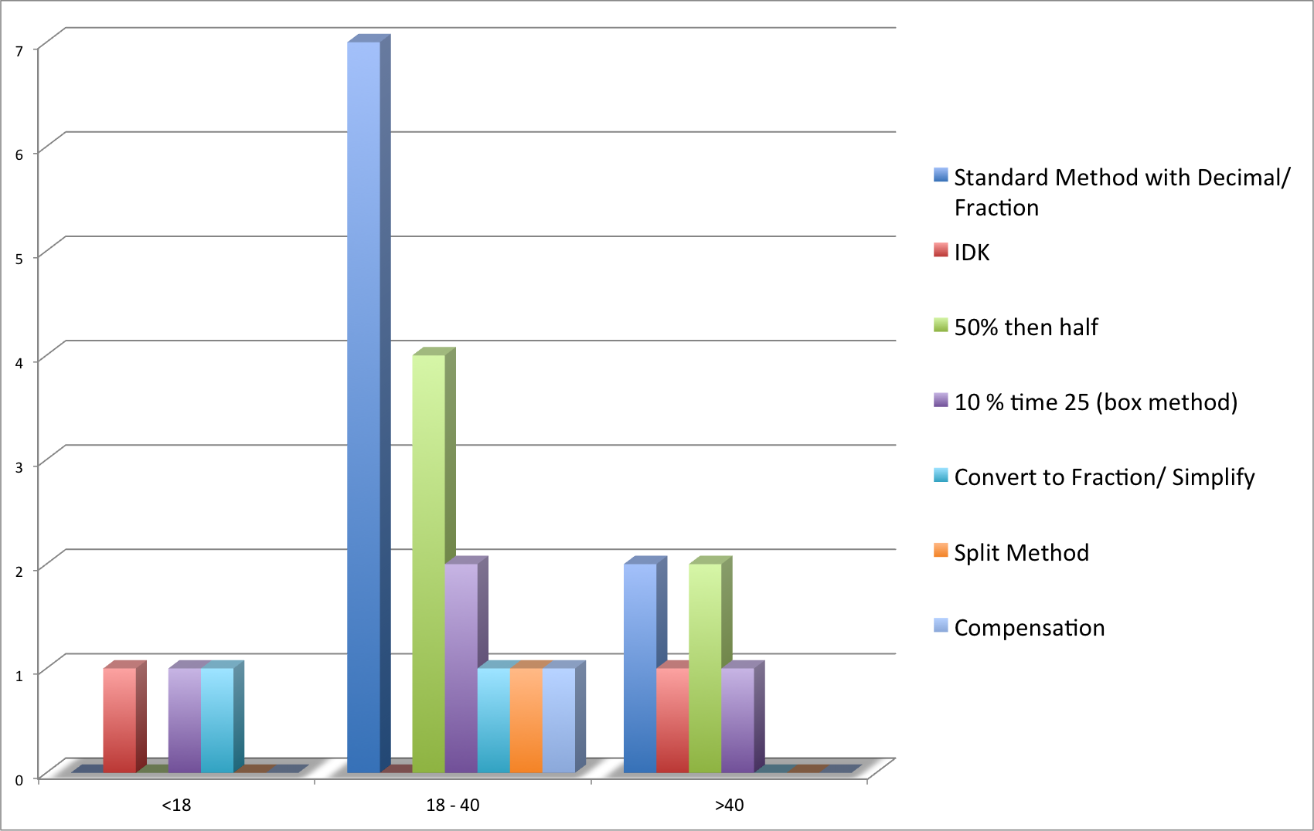
Problem #5: 25% of $3.72
Age
Notes:
<18 – IDK, 10% times 25 (box method), convert to fraction/simplify
18-40 – standard method decimal/fraction, 50% then half, 10% times 25 (box method)
>40 – Standard method decimal/fraction, 50% then half

Slide 22
Strategies Used: A Conclusion
Standard Method w/ conversion to decimal or fraction
50% then half
10% time 25 (box method)
Convert to fraction/ simplify
Split Method
Compensation
IDK
Most common strategies:
  50% then half/ Standard Method
  <18 – IDK, 10% times 25 (box method), convert to fraction/simplify
  18-40 – standard method decimal/fraction, 50% then half, 10% times 25 (box method)
  >40 – Standard method decimal/fraction, 50% then half
Most effective strategies:
  50% then half

