Slide 1
Instructional Coaching Models
Hannah Taylor, Sana Al-Harash, Wei Nan (Nancy), Ben Slater- June 2021

Slide 2
The GROW Model
By Hannah Taylor

Slide 3
What is the GROW model?
Model adapted from Performance Consultants (2021)
G
R
O
W
GOAL
REALITY
OPTIONS
WILL
What do you want to achieve?
What is the current situation?
What can you do to reach your goal?
What will you do to achieve your goal?
Developed in 1980’s by by business coaches Graham Alexander, Alan Fine, and Sir John Whitmore (Mind Tools Content Team, 2019)
One of the most common and most successful coaching models used across cultures and disciplines (Performance Consultants, 2021)

Slide 4
GROW Model: Information & Benefits
Assumes the coach is not an expert that makes decisions, rather a facilitator helping guide decisions
Requires the coach to ask insightful questions and listen actively
(Mind Tools Content Team, 2019; MindToolsVids, 2019; YourCoach BV, 2021)
Useful for the:
  Individual - singular personal or professional goals (I.e., Ipad integration in a single classroom)
  Team - joint goals (I.e., LMS integration for all primary classes)
  Organization/Management - helps non-professional coaches mentor employees (I.e., school-wide professional development and training)
(Management Consulted, 2020)
Benefits according to Performance Consultants (2021):
  Engaging
  Increases self-confidence and motivation
  Carefully structured questions “promote deeper awareness and greater responsibility”
  “Yield[s] higher productivity, improv[es] communication, [creates] better interpersonal relationships, and a better quality working environment”

Slide 5
GROW Model: Step by Step (G)
Aim: Use SMART goals to define short and long term objectives
(Mind Tools Content Team, 2019; YourCoach BV, 2021)
Questions to consider:
What do you want to achieve?
What does your goal mean to you?
When will you meet your goal?
How will you know that you have achieved this goal?
How will you know that the problem or issue is solved?
Does this goal fit with your overall career objectives? And does it fit with the team's objectives?
List of questions summarized from various sources such as Mind Tools Content Team (2019), MindToolsVids (2019), etc.
More about SMART goals can be found by Thorpe (2020)
G
GOAL
What do you want to achieve?

Slide 6
GROW Model: Step by Step (R)
Aim: Identify the current situation
(Mind Tools Content Team, 2019; YourCoach BV, 2021)
Understanding the current reality may cause natural solutions to emerge
The coach’s role is to “stimulate self-evaluation” (YourCoach BV, 2021)
Questions to consider:
What is happening now (what, who, when, and how often)? What is the effect or result of this?
Have you already taken any steps toward your goal?
Does this goal conflict with any other goals or objectives?
What supports do you need to achieve your goal?
What challenges do you expect to encounter? How might you deal with them?
List of questions summarized from various sources such as Mind Tools Content Team (2019), MindToolsVids (2019), etc.
R
REALITY
What is the current situation?

Slide 7
GROW Model: Step by Step (O)
Aim: Explore options for working towards objectives
(Mind Tools Content Team, 2019; YourCoach BV, 2021)
Time to identify all possible options for reaching their objective
Have the team member brainstorm ideas first, then make suggestions if you have some
"Important to guide them in the right direction, without actually making decisions for them" (Mind Tools Content Team, 2019)
Questions to consider:
What else could you do?
What if this or that constraint was removed? Would that change things?
What are the advantages and disadvantages of each option?
What factors or considerations will you use to weigh the options?
What do you need to stop doing in order to achieve this goal?
What obstacles stand in your way?
List of questions from Mind Tools Content Team (2019)
O
OPTIONS
What can you do to reach your goal?

Slide 8
GROW Model: Step by Step (W)
Aim: Establish the will and way forward
(Mind Tools Content Team, 2019; YourCoach BV, 2021)
With the current reality and options identified, "your team member will now have a good idea of how they can achieve their goal"
Time to identify specific actions to move forward, "help them establish their will and boost their motivation"
Provide accountability by deciding on a date to review the progress or change their approach if the plan is not working
(Mind Tools Content Team, 2019)
Questions to consider:
So, what will you do now, and when? What else will you do?
What could stop you moving forward? How will you overcome this?
How can you keep yourself motivated?
When do you need to review progress? Daily, weekly, monthly?
Rate their commitment on a scale of 1-10, what do they need to change for it to be a 9 or 10? Identify practical actions
W
WILL
What will you do to achieve your goal?
List of questions summarized from various sources such as Mind Tools Content Team (2019), MindToolsVids (2019), etc.

Slide 9

GROW Model: Supplementary Tools & Tips
Do not ask closed questions
Use active listening skills
The coach is there to guide, not decide
Use SMART goals
According to Lucid Content Team (2019), help motivate and engage by using visualization tools (I.e., Timeline, Process Flow Chart, KanBan Board)

Slide 10
The OSCAR Model
By Sana Al-Harash

Slide 11
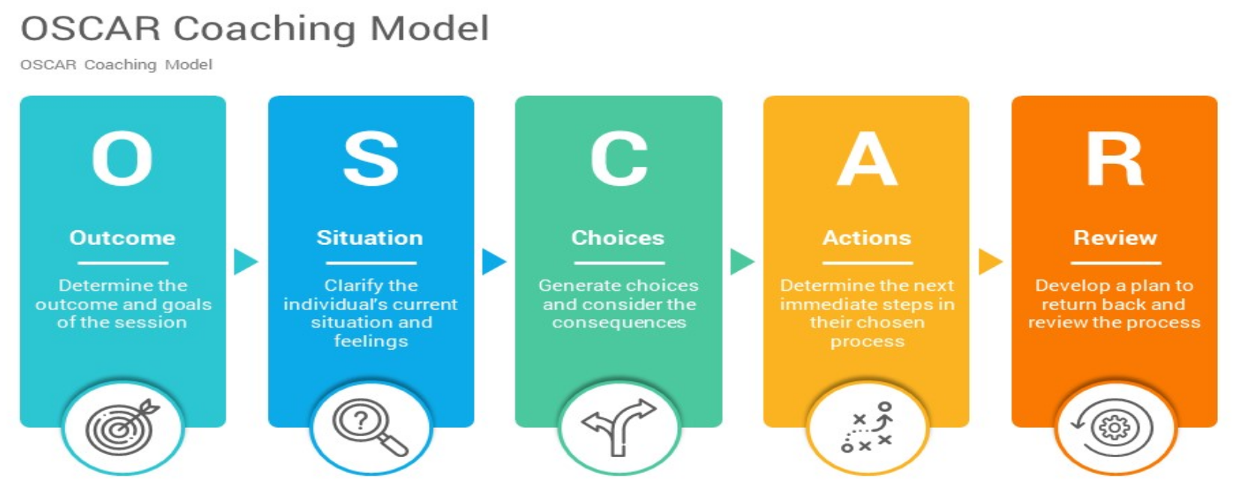
What is the OSCAR model?
Building from the GROW model, the OSCAR model was formulated in 2002 by British coaches and trainers Andrew Gilbert and Karen Whittleworth. Their aim was to provide those in managerial positions with the ability to adopt a development coaching style, to benefit their company and team.
Reference: Mulder, P. (2019). OSCAR Coaching Model. Retrieved [insert date] from toolshero: https://www.toolshero.com/management/oscar-coaching-model/

Slide 12
Goal of the OSCAR Coaching Model
The OSCAR Model is a solution-oriented coaching method (does not focus on cause).
Goal is to help managers increase and improve their employees’ performance and professional efficiency.
The manager, who will be the coach, guides this five step process.
Is usually done virtually.

Slide 13

Outcome
This is where the coach helps the team member clarify the outcomes desired for the session, both long-term and short-term.
Questions to consider at this point:
What would you like to achieve from today’s session?
What is your long-term outcome?
WHat would success look like?

Slide 14

Situation
The coach gets clarity at where the team is right now.
Questions to consider at this point:
What is the current situation?
What is actually happening?

Slide 15

Choices
The coach helps the team generate as many alternative choices as possible and raise awareness about the consequences of each possible choice.
Questions to consider at this point:
What choices do you have?
What options can you choose from?
What are the consequences of each choice?
Which choices have the best consequences?

Slide 16

Actions
The coach helps the team member clarify the next steps forward and take responsibility for their own action plan.
Questions to consider at this point:
What actions will you take?
What will you do next?
What will you do next?
How will you do it?
When will you do it, with whom?
On a scale of 1-10, how willing are you to take those actions?

Slide 17

Review
This step creates an ongoing process of review and evaluation. THis requires the coach to continuously check with the team to make sure that they are on track.
Questions to consider at this point:
What steps will you take to review your progress?
When are we going to get together the review progress?
Are the actions being taken?
Are the actions moving towards your outcome?

Slide 18
The FUEL Model
By Wei Nan (Nancy)

Slide 19
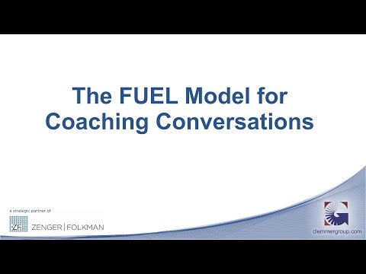
What is FUEL Coaching Model?
The FUEL Model of coaching was developed by John Zenger and Kathleen Stinnett. Instead of telling or advising the coachee how to do/deal with the situation, the coach asked the coachee the open-ended questions or non-leading questions to help the coachee to make their own solution plan.
(The Peak Performance Center, 2017, April 12)
(Jim Clemmer. 2016, April 20)

Slide 20
FUEL Model-What is the FUEL meaning?
Frame
Understand
Explore
Lay
Frame the Conversation
Understand the Current State
Explore the Desired State
Lay out a Success Plan
Set the context and focus for conversation. Agree on purpose, process, and desired outcomes for the discussion.
Help the individual gain awareness about their current situation to determine their perspective.
Help the individual to think about and determine their desired state. Generate multiple alternative paths to achieve that desired state.
Help the individual create a detailed action plan with specific, time-bound steps to be taken to achieve the goal.
Text credited to The Peak Performance Center

Slide 21
FUEL Model Step by Step (F)
In this step, the coach need set up a safe and comfortable atmosphere for the conversation. The coach and coachees can work out the purpose, process and expected consequences. In framing the conversation, the coach lead the conversation process. The coachee will manager the content.
The coach’s questions only help the coachee to think deeper and analysis the issue, and always use “what” or “how” to ask the questions.
Possible questions to ask the coachee:
What is the most important thing for us to focus on?
What else would you like to make sure that we address?
What would you like to accomplish in this conversation?
How might I help you with this issue?
(NYU. Retrieved June 3, 2021)
F
Frame
Set the context and the focus for the conversation

Slide 22
FUEL Model Step by Step (U)
This step is to help the coach to figure out how the coachee’s thoughts about the current situation. And trying standing the angle of coachee to understand his/her views.
Possible questions to ask the coachee (open-ended & non-leading questions)
How do you see this situation?
What is happening?
How might others see the situation?
What impact is this having on you? On others?
What are the consequences if the situation doesn’t change?How does this influence your goals and what you are trying to accomplish?
Could I share some observations I have made?
(NYU. Retrieved June 3, 2021)
U
Understand
Explore the individual’s point-of-view before sharing your own

Slide 23
FUEL Model Step by Step (E)
In this step, creating a successful vision for the coachee, either having a person tell exactly what the desired state or other path to make the coachee have the awareness of the desired state. Once the “F” and “U” steps helped the coachee understand his/her current state. This step will lead the coachee have full vision of desire state, which move the coachee generate the action plan to achieve the end state.
Possible questions for this step:
What does the desire state look like?
What would your ideal state look like?
What are your goals? What would you like to accomplish?
What might be some approaches you can take?
What are the major barriers preventing this change from happening?
Could I offer a couple of thoughts? You might want to consider . . .
(NYU. Retrieved June 3, 2021)
E
Explore
Identify the target and generate multiple paths to achieve the end state

Slide 24
FUEL Model Step by Step (L)
This is the last step of FUEL model. The coachee followed the action plan in details to implement each action within the timelines. The coach helps the coachee to identify all the barriers and set up the milestone to complete the action plan, achieving the desired outcome.
Possible questions for this step:
What specific actions will help you achieve your goal?
What will your first step be?
Who can support you moving forward?
How can I support you in moving forward?
Let’s review the plan.
When should we touch base on this again?
(NYU. Retrieved June 3, 2021)
L
Lay
Create the detailed, actionable plan and follow-through that will lead to goal attainment

Slide 25
Transformational Coaching
By Ben Slater

Slide 26
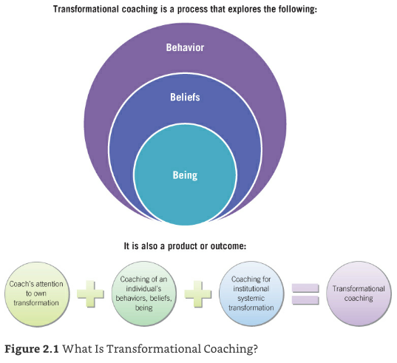
What is Transformational Coaching (TC)?
(Aguilar, 2013, pg 25)
TC is a holistic approach that intends to affect 3 areas:
Behaviours, beliefs and being (of coachee)
Institutions & Systems (departments/teams/school) (that the coachee works in)
Educational and social systems (that the coachee lives in)
TC incorporates strategies from directive & facilitative coaching, as well as cognitive & ontological.
Who is it for?
Coaches to coach Teachers and Administrators
Administrators to coach Teachers
Developed by Elena Aguilar - https://brightmorningteam.com/

Slide 27

TC’s core principles
‘Behaviours, beliefs and being’ - What does that mean?
Doing (Behaviour) = required tasks to do the job (teaching/administrating)
Below Behaviour = What we think and believe about what we are doing - principles
Below Belief/Thinking = Being = identity / ways of communicating / emotions
These are the 3 elements that when worked on holistically will lead to transformation.
TC is context aware
Teachers teach in classrooms within schools, which exist in a district.
The teaching environment is influenced by systemic issues beyond the classroom.
TC takes the Coachee’s context into account, finding connections between the individual’s beliefs, the institutions and systems within which they work and the boarder educational system.

Slide 28

TC Process 1 - Beliefs affect coaching
Before Coach can coach, Coach’s beliefs should be aligned with values.
‘No one can learn from you if you think that they suck.’ (Aguilar, 2013, pg 33)
Our beliefs drive our actions.
Sometimes our beliefs contradict each other or our core values.
Some beliefs make us strong, some weaken us.
But they can be changed.
We don't see things the way they are; we see things the way we are.
The Talmud
(Aguilar, 2013, p. 35)
Are Coach’s beliefs aligned?
Yes!
Now Coach can work with Coachee to align their beliefs.
‘Who do you want to be?’

Slide 29

TC Process 2 - What must a Coach know?
The work of a Transformational Coach is to look at every situation from different perspectives, through the ‘coaching lenses’.
TC’s lenses are:
Inquiry
Change Management
Systems thinking
Adult learning
Systemic oppression
Emotional Intelligence
These are used to examine relationships, individuals, institutions and phenomena.
Each lens provides focus for some things, while others are blocked out.
They are overlapping and interrelated, their purpose is to think critically, and take informed action. (The National Equity Project, 2007 as cited in Aguilar, 2013)

Slide 30

TC Process 3 - Establishing Coaching with Client
Working with a Coach is often not a decision that the coachee makes for themselves, as it will come from Administration. Hence building trust and maintaining it throughout is vital.
Develop Trust - Useful lenses in this stage - Emotional Intelligence + Adult Learning
1. Plan & Prepare 2. Gather background info
3. Establish Confidentiality 4. Listen
5. Ask Questions 6. Connect
7. Validate 8. Be open about who you are/what you do
9. Ask for permission to Coach 10. Keep Commitments
Exploration - Useful lenses in this stage - Systemic Oppression + Systems Thinking
1. Gather Relevant Documents 2. Gather and Analyze formal data
3. Initiate Formal Conversations 4. Uncover Knowledge, Skills, Passions
5. Explore Beliefs and Change 6. Offer Personality and Psychological Self-Assessments
7. Observe the Client 8. Conduct Formal Interviews and Surveys
9. Look for the fires 10. Engage in Self-Awareness Exercises
Planning - Useful lenses in this stage - Change Management + Inquiry + Adult Learning
1. Identify areas for coaching 2. Identify standards and criteria
3. Determine a SMARTE goal 4. Identify high-leverage activities
5. Break down the learning 6. Determine indicators of progress
7. Develop coaching theories 8. Determine coach’s goals
9. Compile resources 10. Present and Celebrate plan

Slide 31

TC Process 4 - ‘The Coaching Dance’
TC practice involves three key disciplines, listening, questioning and action.
The Coach often takes the lead as she has the expertise, but if or when the Coachee suggests a new direction, the Coach should encourage and follow. (Aguilar, 2013, pg 147)
So the order in which these 3 disciplines take place will vary between clients and in different phases of the coaching process, frequently switching from one to another as required.
Listening
Listening properly is perhaps the most important skill a Coach needs to have and develop. If the issues, requirements and aspirations of the Coachee, institution and district are to be properly understood, then the Coach must listen intently and continuously to all parties involved.
Questioning
Every Coaching Model has lists of Questions that can be used during each phase of the coaching process.
TC is no different, drawing its questions from 2 traditional coaching disciplines; facilitative and directive. It is the job of the Coach to know when to question in the appropriate style.

Slide 32

TC Facilitative + Directive Coaching Activities
Action
Facilitative Coaching Activities = pull client toward learning
What most people would describe as ‘the job’ of the Coach.
Work in conjunction with more directive activities, the two ‘modes’ support each other.
Visualization and Guided Imagery Role-Playing
Videotaping Surveys
Positive Self-Talk Writing
Exploring Metaphors Storytelling
Visual and Artistic Activities
Directive Coaching Activities = push the client toward learning
Instructive (directive) activities are sometimes the most appropriate, but they should always be supported with facilitative learning activities to reflect and deepen learning.
Observations Giving Feedback
Modeling (lessons/record keeping/routines/procedures) Elbow teaching
Lesson and Unit Planning On-the-spot Coaching
Field Trips Shared Reading
Looking at Data Coaching on time Management
Activities are there to help the client move toward meeting the client’s goals - always moving from and towards goals.

Slide 33

TC Process 5 - Closing the Conversation
Coaching sessions should:
Facilitate learning
Push a client’s thinking
Provoke reflection and growth
At the end of a session we need to know if the client:
Felt inspired/empowered
Clear about next steps
Confident that she can take them
Coach and Coachee should then agree dates next steps will be achieved + agree when they will next meet.
Following the session the Coach should review the meeting and reflect.
What new information was discovered?
Does it affect the way forward?
Plan for the next meeting

Slide 34
Choice of Models

Slide 35
Hannah’s Choice of Model: GROW
If I were to choose a coaching model for the International School of Twente, I would choose the GROW model. Easy to understand and straightforward to implement, the GROW model is aptly stated to be one of the most commonly used and most successful coaching models across various disciplines and cultures (Performance Consultants, 2021). The G in the model is based on identifying SMART goals, Specific, Measurable, Actionable, Realistic, and Time Bound (Thorpe, 2020). I have become very familiar with using SMART goals in the past and I find they are a great way to form an action-oriented mindset with goal setting. Further, the R in the GROW model is dependent on analyzing the reality of the situation (Mind Tools Content Team, 2019; MindToolsVids, 2019; YourCoach BV, 2021). This means the model is not only action-oriented, but realistic. The GROW model requires you to assess exactly where the coachee is at (in terms of current progress, abilities, knowledge, etc.- the R), what could be/needs to be done to meet the goal (the O), and what the coachee or organization is willing/able to do out of the options available (the W) (Mind Tools Content Team, 2019; MindToolsVids, 2019; Performance Consultants, 2021; YourCoach BV, 2021). A model that is rooted in reality and provides SMART goals would be an ideal coaching strategy for a school that has limited resources, limited development time, limited staff, and the complicated context of being an international school, like the International School of Twente. Such a model provides the clarity and flexibility that is necessary to plan development despite these obstacles. In particular, I believe the teachers will be more receptive to this model than others because it meets them where they are at (referring to their current reality) and guides their development plan using their own ideas, wishes, and willingness to reach goals. This kind of coaching model will appear less forced by admin or the governing board and allows teachers and staff to take ownership of development in the school. I believe this model will also be more flexible. The final step in the GROW model considers the willingness, and of course ability, of the individual, team, or organization, to complete options that work towards an objective. A model that takes into consideration the amount of time a teacher or staff member is willing/able to put into reaching a goal is necessary when they already have so many responsibilities or projects to take care of. By using this model, teachers and admin at IST will be able to identify their goals for their classrooms or the school and walk away with the knowledge and plan they need to start working towards those goals in a timely and comfortable manner.

Slide 36
Sana’s Choice of Model: OSCAR
Although I have no experience in coaching, from what I gathered about the OSCAR model I feel like it would be the model of my choice at my school. It fulfills every need that I feel like I would need from a coach if I were the trainee. The model helps employees improve their performance and professional efficiency, which is what all employers want. What draws me to this model most is the “Review”, which is the last set. I like that this process is ongoing, so the trainee doesn't feel unsure about reaching their goal. It has been proven to be effective and has won a number of awards. (Worth COnsulting, 2002)
“Worth Consulting’s learning model known as OSCAR has revitalised an ailing manufacturing firm – and bagged a prestigious training award into the bargain. The most startling change has been the fall in absenteeism from 5.4% to 3%, which has saved the company £98,000 in the past 18 months.” (People Magazine)
Maybe later in the profession I would have a different opinion, but for now this is the Model of my choice.

Slide 37
Nancy’s Choice of Model:
After looking through all 4 coaching models in this PPT. I would like to choose the GROW coaching model for my school.
Comparing the 4 models, the OSCAR coaching model is also straightforward, but this model does not focus on the cause, which might not be suitable for education. For example, every teacher teaches the same knowledge in different ways. We cannot ignore the cause of the issue. Talking about the Transformational coaching model, I think it is too complicated and also needs to take a longer time to see the outcome. As for the FUEL coaching model, this model might not suit most of the students and some teachers, as this model is more like a self-coaching model, the coach will not guide you or give you specific advice/guidance, it relies on the coachee’s own creative ability, self-analysis and so on. This model is more suitable for talented students and teachers.
The GROW model would be the best option for my situation. First of all, the GROW model is easy to understand and implement. As I don’t have too much coaching experience, beginning with a simple one probably is a smart option. Secondly, it is a flexible coaching model, you could set up the different level goals, not necessarily to be the utmost goal. Therefore, the coachee is easy to receive the effects. Finally, our school is more like a language training centre, all the teachers are based on different campuses and we do not have a professional coach or coaching process, it is difficult to choose a complicated coaching model for our school's current situation.
To sum up, start from simple model and set up short term goals, then long term goals are probably more realistic for our school.

Slide 38
Ben’s Choice of Model:
It has been very interesting and valuable time spent reading around the Transformational Coaching model, but I would not want to try to follow or implement it yet, both from a personal perspective and from an organisational perspective.
As Nancy rightly says above it is complicated. I think it is the most comprehensive model here, possibly anywhere, and that is very deliberate. Its author and most public protagonist - Elena Aguilar - (her name means Shining Light Eagle) set out to illuminate every aspect of her clientele’s working environment within the education sector, at a micro, meso and macro level (the eagle really does see all) and the dynamics and relationships that are involved at all of those levels, between all the players; individuals teachers, the teaching body, administration, the institution, the district and its leaders and policies. It is impressive work and could very well be the ultimate coaching model, but not a place to begin. It would require years of experience within the education world to do it, and any clients, justice.
For these reasons, but mainly because it is straightforward, to the point and effective, the school I am working with, should it look to benefit at all from Coaching, would do so from the GROW model. GROW’s focus on DOING, on achieving results in the shortest time available, will suit the leadership of the Innovation Academy, which as a small operation has scarce resources. Also, they would not be looking for a Coach to work with them on a personal development level, particularly as they are teachers with years of experience and I am not. Therefore the GROW model applied within a tech implementation context is the most appropriate.

Slide 39
References 1
Lucid Content Team. (2019, July 10). 4 Steps to Achieving Your Goals Using the GROW Method. Retrieved from https://www.lucidchart.com/blog/how-to-use-the-grow-method
Management Consulted. (2020, December 09). What is the GROW Coaching Model? Retrieved from https://managementconsulted.com/grow-coaching-model/
Mind Tools Content Team. (2019, May 3). The GROW Model of Coaching and Mentoring: A Simple Process for Developing Your People. Retrieved from https://www.mindtools.com/pages/article/newLDR_89.htm?utm_source=youtube&utm_medium=video&utm_campaign=growmodel&utm_content=description
MindToolsVids. (2019, December 22). Retrieved June 01, 2021, from https://www.youtube.com/watch?v=1fbooiSh_bA
Performance Consultants. (2021, April 21). The GROW Model. Retrieved from https://www.performanceconsultants.com/grow-model
Thorpe, D. (2020, December 13). Be SMART About Your Goal Setting. Retrieved from https://dougthorpe.com/be-smart-about-your-goal-setting/
YourCoach BV. (2021, January 21). GROW Coaching Model. Retrieved from https://www.yourcoach.be/en/coaching-tools/grow-coaching-model/
Mulder, P. (2019). OSCAR Coaching Model. Retrieved [2021, May] from toolshero: https://www.toolshero.com/management/oscar-coaching-model/
Gilbert, A., & Whittleworth, K. (2009). The Oscar Coaching Model. Lulu. com

Slide 40
References 2
Jim Clemmer. (2016, April 20). The FUEL Model for Coaching Conversations [Video]. YouTube. https://www.youtube.com/watch?v=l3fur-iSg4U
FUEL Coaching Model. (2017, April 12). The Peak Performance Center. https://thepeakperformancecenter.com/development-series/skill-builder/interpersonal/coaching-for-performance/coaching-model/fuel-coaching-model/
FUEL Coaching Framework – Coaching for Leadership. (n.d.). NYU. Retrieved June 3, 2021, from https://wp.nyu.edu/coaching/tools/fuel-model/
FUEL Coaching Model. (2017b, April 12). The Peak Performance Center. https://thepeakperformancecenter.com/development-series/skill-builder/interpersonal/coaching-for-performance/coaching-model/fuel-coaching-model/
Aguilar, E. (2013). The art of coaching : effective strategies for school transformation. Wiley.
Home - Bright Morning. (2021, April 16). Bright Morning. https://brightmorningteam.com/
Magiera, J. (2019, July 9). Want Transformational Teachers? Here’s Why Change Starts With Coaches. EdSurge; EdSurge.
https://www.edsurge.com/news/2019-07-09-want-transformational-teachers-here-s-why-change-starts-with-coaches
Sutton, J. (2020, October 7). 12 Effective Coaching Models to Help Your Clients Grow. PositivePsychology.com.
https://positivepsychology.com/coaching-models/
Transformational Coaching Guide - Animas Centre for Coaching. (2021, May 10). Animas Coaching.
https://www.animascoaching.com/our-knowledge/faqs/what-is-transformational-coaching-98/
Wilson, A. (2013). Coaching Models. Teaching, Learning, Laughing.
http://teachinglearninglaughing.weebly.com/coaching-models.html
Yaron, L. (2017, January 11). The 10 Key Elements of Transformational Coaching (Opinion). Education Week. https://www.edweek.org/education/opinion-the-10-key-elements-of-transformational-coaching/2017/01

