Slide 1
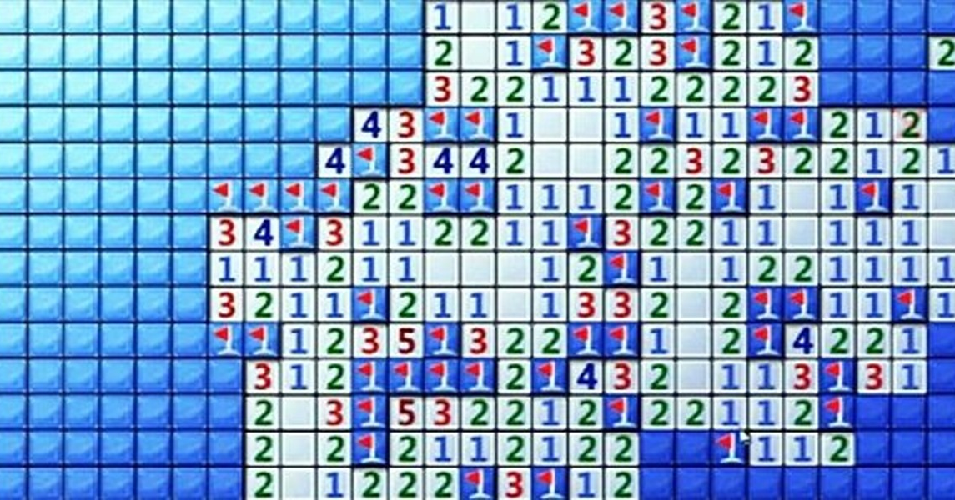
Math Minesweeper:
Identifying Prime Numbers
Chelsie Hill, hannah Taylor, Asha Parkinson Tee, Lieke Wolbers
November 23, 2017 Stenden Iteps M1

Slide 2
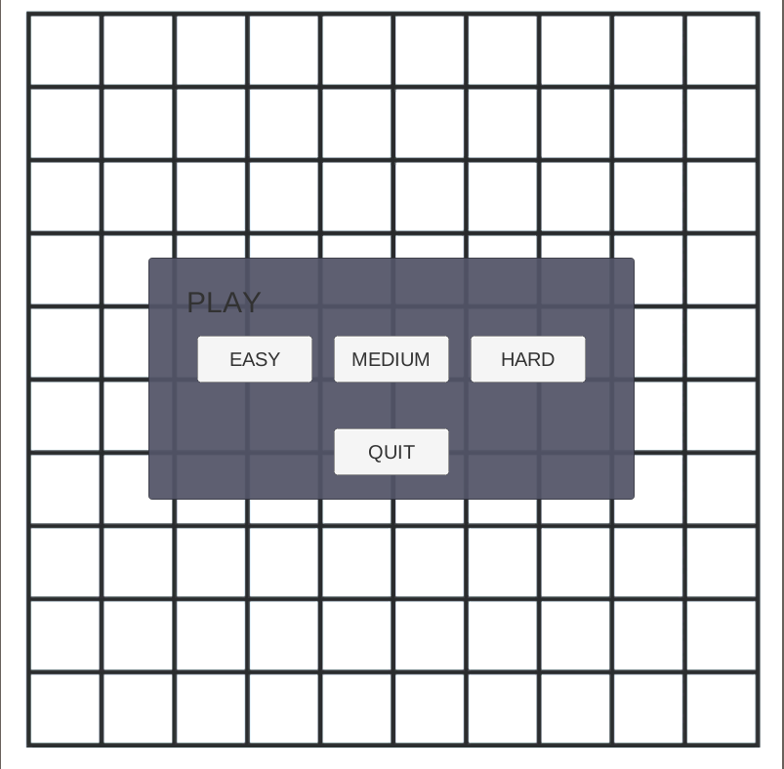
The Aim:
Identifying Prime Numbers
This game has 2 levels preparing the student for the final level where there prime number identifying skills will be put to the test in a life or BOOM situation.
The students will complete the levels using strategies learned about multiplication and prime numbers

Slide 3
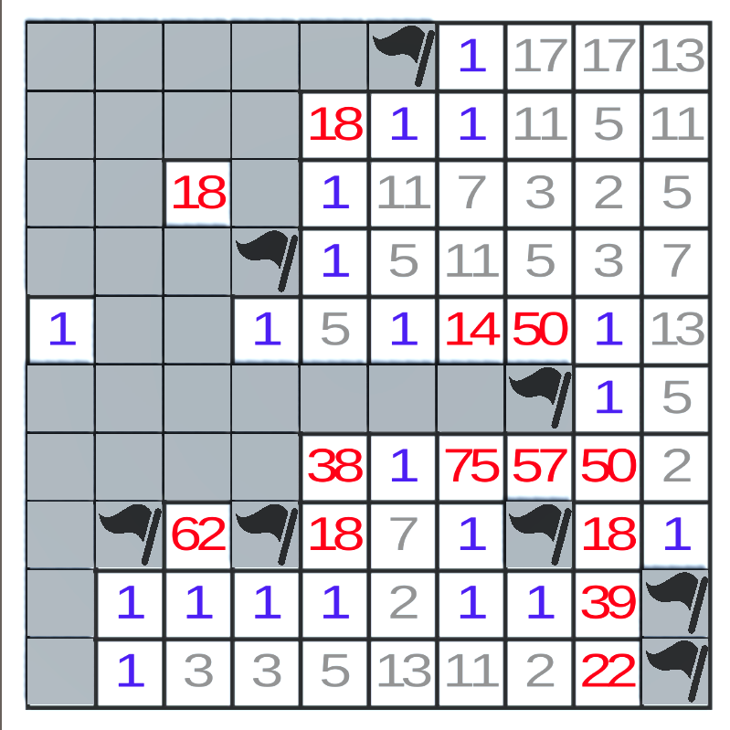
The Levels:
Level Easy & Medium
The first and second level is similar to the basic minesweeper there are fewer bombs in easy and more bombs in medium.
The prime numbers are different colors than the composite numbers to assist in identifying the prime numbers.

Slide 4
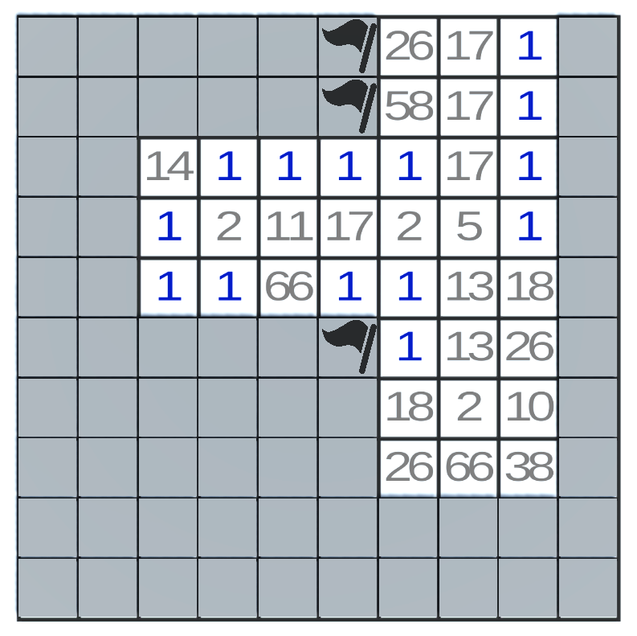
The Levels:
Level Hard
In this level the prime and composite numbers are the same color making it more difficult to identify the safe path.
This level is for students who feel confident in their use of strategies to identify prime numbers.

Slide 5
The Strategies
Divisibility Strategies
Identifying Number Relations
Identifying Prime Number Strategies
Patterns in certain multiplication tables
Rehearsing generalizations around prime numbers
8 strategies – Including:
  Even numbers are always divisible by 2
  Numbers which digits add up to 3, 6, or 9 are divisible by 3
"Direct search factorization"
2 Shorcuts
Tree Method
"Cake" Method

Slide 6
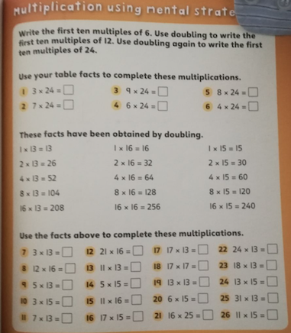
The Strategies
Identifying Number Relations
Patterns in certain multiplication tables e.g. 5 times table will have a ones digit of either 5 or 0, the 9 times table decreases by one in the ones place and increases by one in the tens place ie 9, 18, 27, 36
Rehearsing generalizations around prime numbers ie a prime number is only divisible by 1 or itself

Slide 7
Even numbers are always divisible by 2
Numbers which digits add up to 3, 6, or 9 are divisible by 3
Numbers which end in 0 or 5 are divisible by 5
Numbers that yield an even answer when divided by 2 also divide by 4
Even numbers that also divide by 3 are divisible by 6
Numbers that are still even after three divisions by 2 are divisible by 8
Two digit numbers ending in 0 are divisible by 10
Numbers below 100 that have double digits are divisible by 11.
Divisibility Strategies

Slide 8
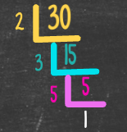
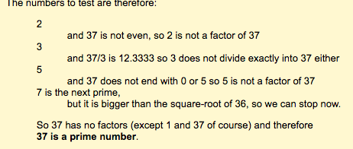

The Strategies: Identifying Prime Numbers
Methods
"Shortcuts"
Direct Search Factorization
Tree Method: Factorization trees
"Cake" Method : Similar to long division creates and upside-down cake. Write the division sign upside down the try to divide by the lowest prime number (2), if it does not work try the next prime number until you find one that divides. Then write the quotient underneath and do the steps again. Keep using the patter until your quotient can only be 1.
Shortcut 1: Only test prime numbers smaller than the number you are testing as possible factors
Shortcut 2: (Advanced) Suppose one number is a factor of N and that it is smaller than the square-root of the number N. Then the second factor must be larger than the square-root
All possible factors are systematically tested using trial division to see if they actually divide the given number
When using this method on a number , only divisors up to n(^-2) need to be tested. This is true since if all integers less than this had been tried

Slide 9
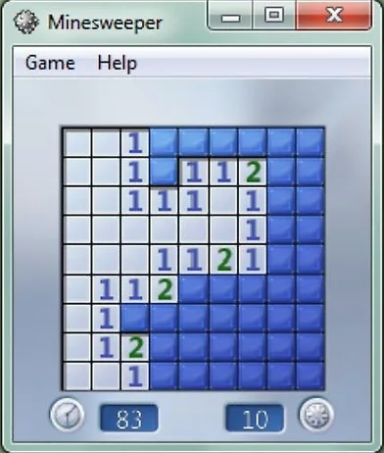
Original Minesweeper Rules
1. Select a difficulty level.
2. Click any square, preferably towards the middle. Left clicking uncovers the contents of a given tile. Right clicking or holding alt while clicking marks a tile as a suspected bomb.
3. Check the numbers to find bombs. As you uncover tiles, you will see numbers revealed. A number means that there are that number of bombs touching that tile (both sides, top/bottom, and diagonally). If you see a 1 on the board, it means that square is touching exactly 1 mine.
4. Click known safe squares. Eliminate squares that can't possibly contain mines by left clicking. Say you found a 1, and you're pretty sure where the mine for that 1 is. You can click all the other squares around that 1 to open them, because the 1 can only be in contact with a single mine.
5. Keep moving through a process of elimination.
6. Practice. After you master Beginner, move on to Intermediate, and then to Expert. As you go on, you'll notice yourself losing less often.
Notes:
wikihow

Slide 10
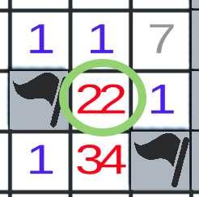
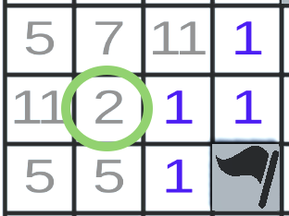
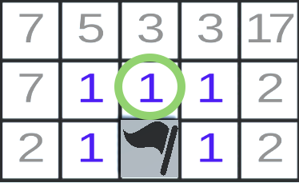
The Rules
1
Composite Number
Prime Number
One bomb touching the square.
(Lowest prime factor of #) bombs touching the square.
No bombs touching the square.

Slide 11
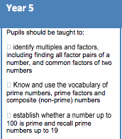
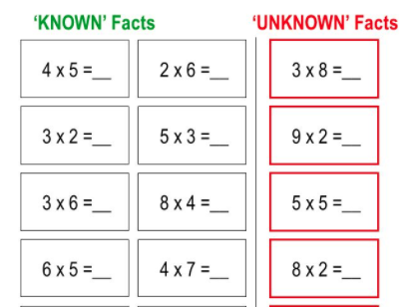
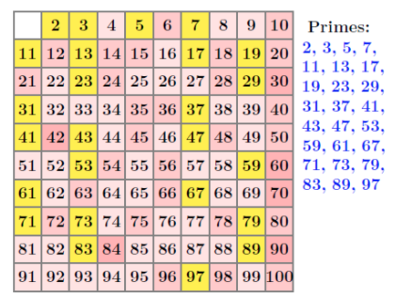
Justification
Math Fact Fluency
Identifying & Generalizing Patterns
Didactical Evidence
Rehearsal of Math Facts & Advantages of Computer Based Practice
Sieve of Eratosthenes
British National Curriculum

Slide 12
Math Fact Fluency
“Recent technology-enhanced programs may open the door for educators to provide students with [the services they need,] without exhausting school resources." -p. 666
Research supports the connection between
  Math fact rehearsal
  Increased retention
  Generalization**
Practice activities led to large effects for students struggling with mathematics, including those with learning disabilities (Nelson, et. Al, p. 660)
For math fact rehearsal to be effective ➔ it should include:
  Materials at an appropriate level
  Practice opportunities that incorporate modeling, feedback, timed practice, self-management, and reinforcement (Nelson, et. Al, p. 660)
“Intervention listed above….not easily achieved” Nelson, et. Al, p. 660)
Technology-based instructional programs
  “Shown to be effective and efficient methods to improve the fluency”
  “Students can recall basic math facts because they allow for individualized practice, modeling, frequent administrations, and brief, timed practice” (Nelson, et. Al, p. 660)
Taking into consideration the students’ skill level and providing
  appropriate levels of practice
  practice materials
Is associated with an increase in students’ achievement (Nelson, et. Al, p. 666)

Slide 13
Identifying & Generalizing Patterns
“Generalization activit[ies] can be extended from previous knowledge to new related concepts." (p. 209)
"Generalization as an important element of mathematical thinking and problem solving has potential to support students’ learning in calculus " (p. 210)
”Generalization is the most important problem which should be introduced for students and they should be encouraged to use it. " (p. 211)
"Generalization helps people to blend their experiences with useful knowledge to solve their problems in new conditions and lets them to be more creative. "(p. 212)
“Generalization is an important activity in the learning of mathematical concepts. "(p. 213)
“Generalization should be applied more in the learning of mathematics." (p. 214)
“Generalization as an important property of mathematics should be used and taught frequently by mathematics teachers" (p. 214)
“[A child’s] ability to continue a pattern comes well before the ability to describe the general term."
3 kinds of generalization:
  Expansive: where the applicability range of an existing schema is expanded, without reconstructing the schema
  Reconstructive: where the existing schema is reconstructed in order to widen the applicability range
  Disjunctive: where a new schema is constructed when moving to a new context
Notes:
Can shorten to Soso et, al emphasizes throughout the article generalization: a, b, c,…

Slide 14
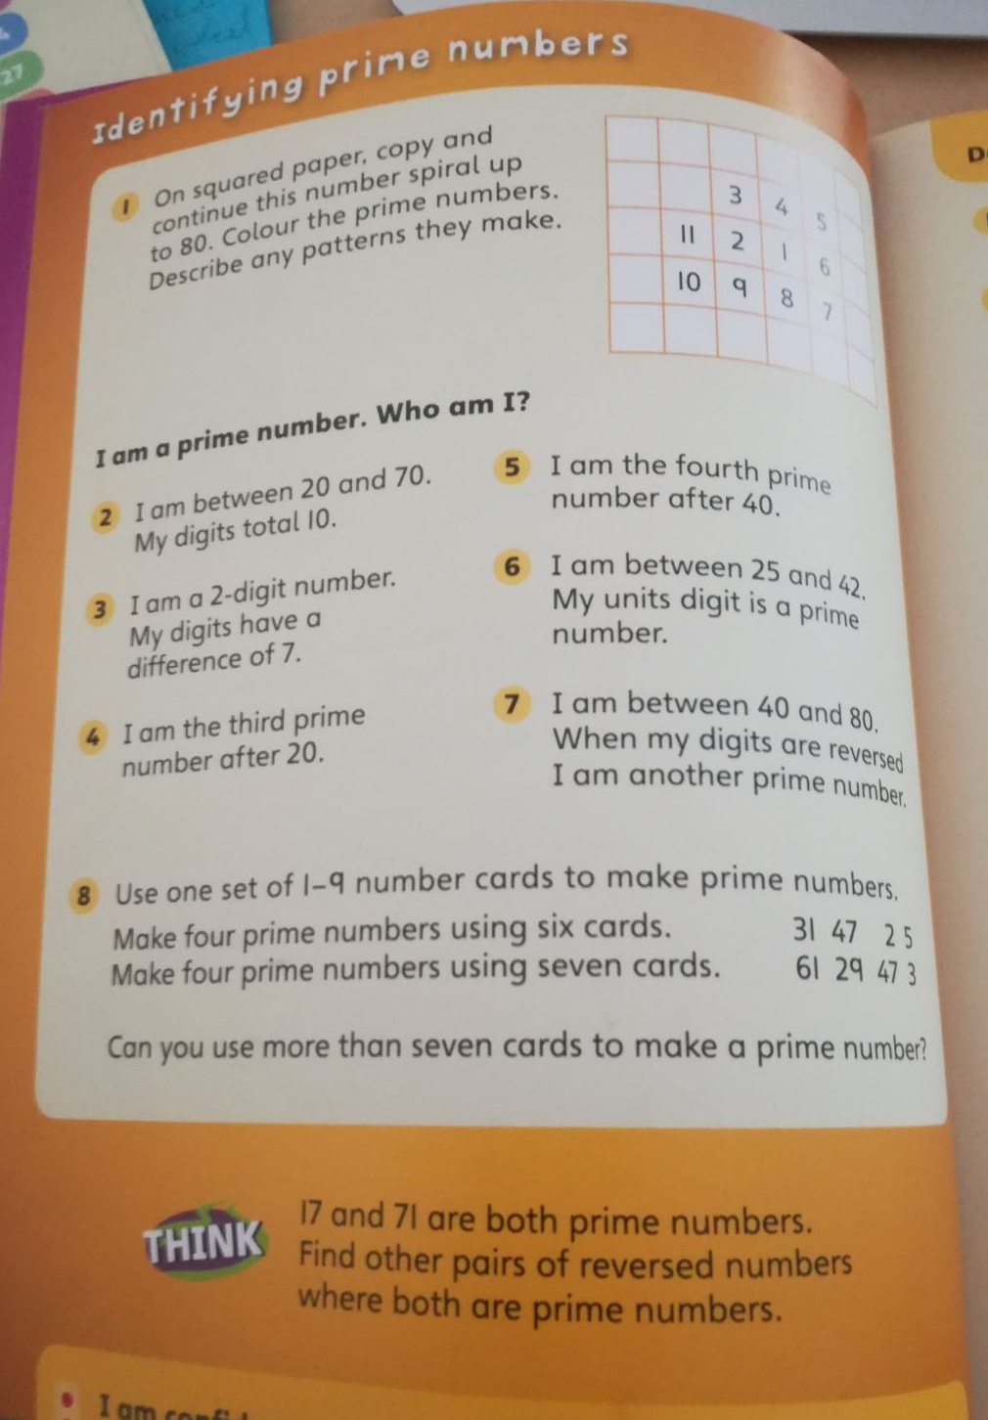
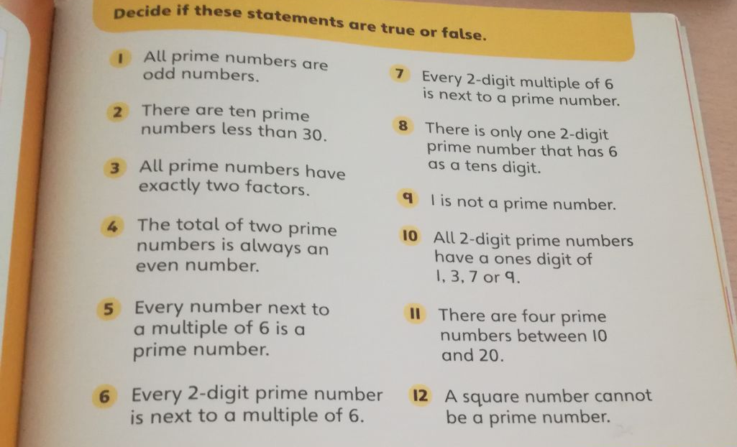
International School of the Hague
6th grade math textbook (p. 52-3)

Slide 15
British National Curriculum 2014
Numeracy Objectives
Year 5 require learning prime numbers and identifying patterns in multiplication
Year 6 takes this further

Slide 16
Add more differentiation
  Level 1 – same as easy
  Level 2 – up to 5 bombs touching
  Level 3 – up to 7 bombs touching
  Level 4 – same as hard, up to 7 bombs touching
and applicabilities
  i.e. addition/subtraction levels
  multiplication/division levels
If we were to publish, we would…

Slide 17

Math Minesweeper 2017
Math Mine Sweeper
Demonstration
https://www.dropbox.com/s/0oj5owgmsuq4cvs/Interviews%20Math%20Minesweeper.mp4?dl=0

Slide 18
References
ZAZKIS, R. and LILJEDAHL, P. (2017). GENERALIZATION OF PATTERNS: THE TENSION BETWEEN ALGEBRAIC THINKING AND ALGEBRAIC NOTATION. [ebook] Burnaby: Simon Fraser University, p.381b. Available at: http://www.peterliljedahl.com/wp-content/uploads/JA-ESM-2002.pdf [Accessed 22 Nov. 2017].
Hashemi, N., Abu, M. S., Kashef, H., & Rahim, K. (2013). Generalization in the Learning of Mathematics. Generalization in the Learning of Mathematics, 209-214. Retrieved from http://educ.utm.my/wp-content/uploads/2013/11/291.pdf
National Curriculum 2014 Numeracy Objectives. (2017). [ebook] Perryfields, p.3. Available at: http://perryfields-pri.sandwell.sch.uk/media/display/National-Curriculum-2014-Maths-Objec.pdf [Accessed 22 Nov. 2017].
wikiHow. (2017). How to Play Minesweeper. [online] Available at: https://www.wikihow.com/Play-Minesweeper [Accessed 22 Nov. 2017].
Wondernumber.com. (2017). The Wonder Number Learning System. [online] Available at: http://www.wondernumber.com/board.html [Accessed 22 Nov. 2017].
Nelson, P. M., Burns, M. K., Kanive, R., & Ysseldyke, J. E. (2013). Comparison of a math fact rehearsal and a mnemonic strategy approach for improving math fact fluency. Journal of School Psychology, 51(6), 660-666. doi:10.1016/j.jsp.2013.08.003

Slide 19
References
En.m.wikipedia.org. (2017). Sieve of Eratosthenes. [online] Available at: https://en.m.wikipedia.org/wiki/Sieve_of_Eratosthenes [Accessed 22 Nov. 2017].
Mathsisfun.com. (2017). Multiplication - Times Tables. [online] Available at: https://www.mathsisfun.com/tables.html [Accessed 22 Nov. 2017].
Thomas, K. (2015, February 25). Prime Factorization Strategies. Retrieved from https://prezi.com/58sxlhe0ntlr/prime-factorization-strategies/
Counton.org. (2017). Count On. [online] Available at: http://www.counton.org/explorer/primes/checking-if-a-number-is-prime/ [Accessed 22 Nov. 2017].
Bright Hub Education. (2017). Classroom Game to Teach Prime & Composite Numbers. [online] Available at: http://www.brighthubeducation.com/elementary-school-activities/104105-prime-and-composite-number-classroom-game/ [Accessed 22 Nov. 2017].
Prime Factorization Algorithms. (n.d.). Retrieved November 22, 2017, from http://mathworld.wolfram.com/PrimeFactorizationAlgorithms.html

